Slide 1
Customer Segmentation Project on Sales data
Tools Used :-
SQL
EXCEL
Tableau

Slide 2
Increase in sales over year
Previous Year | Current Year | % increase in sales
2003 | 2004 | 16.87
2004 | 2005 | -63.97

Slide 3
Total Sales by Product
PRODUCTLINE | TOTAL_SALES
Classic Cars | 1968930.37
Vintage Cars | 867821.11
Motorcycles | 571524.05
Trucks and Buses | 539929.67
Planes | 203616.26
Ships | 72512.18

Slide 4
Total Sales by Deal Size
Deal Size | Total Sales
Medium | 2669832.3
Large | 893336.64
Small | 661164.7

Slide 5
Customer Segmentation
Customer type | Total customers
Active buyers | 20
Lost Customer | 17
Loyal Customers | 8
New Customer | 9
Slipping away Customer | 8

Slide 6
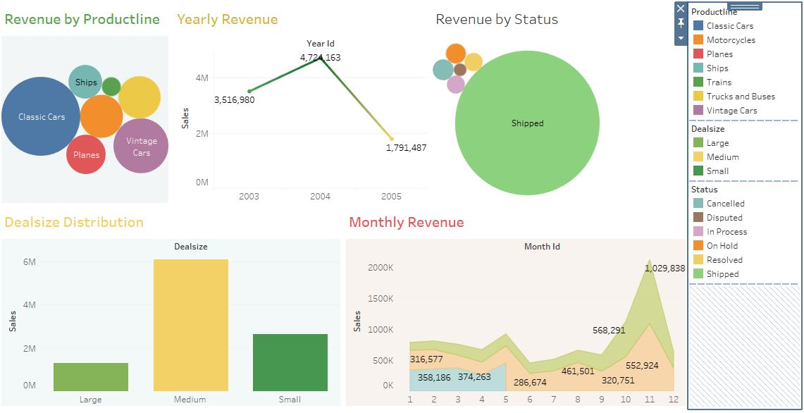
Tableau Dashboard

Slide 7
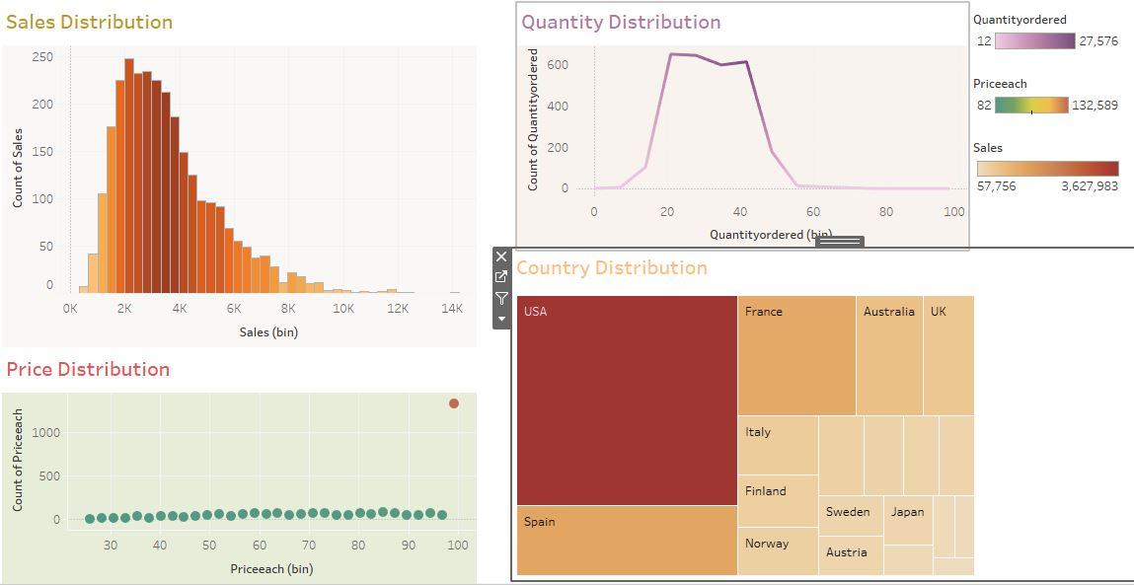

Slide 8
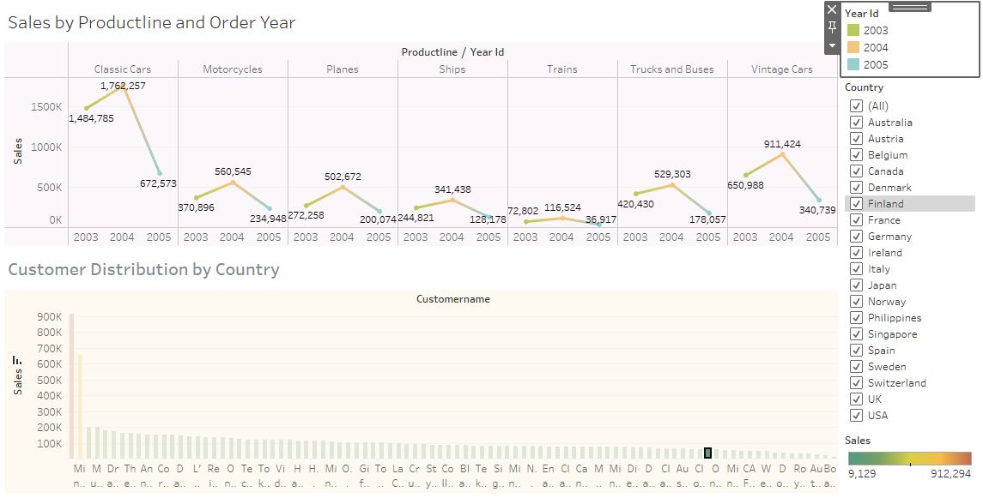

Slide 9
SQL Queries
Increase in sales over year
WITH Sales_y as
(SELECT
YEAR_ID AS 'YEAR', SUM(SALES) AS 'TOTAL_SALES'
FROM sales_data
group by YEAR_ID
)
select
s2.year as 'YEAR',
concat(round(100*(s2.total_sales-s1.total_sales)/s1.total_sales, 2), '%') as 'PERCENT_INC_IN_SALES',
S1.YEAR AS 'PREVIOUS YEAR'
from sales_y s1, sales_y s2
where s2.year>s1.year and s2.year-s1.year=1
order by year asc;

Slide 10
Total sales by productline
SELECT
PRODUCTLINE,
SUM(SALES) AS 'TOTAL_SALES'
FROM sales_data
group by PRODUCTLINE
ORDER BY TOTAL_SALES DESC ;
Total sales by Deal Size
SELECT DEALSIZE, SUM(SALES) AS 'TOTAL_SALES'
FROM sales_data
group by DEALSIZE
ORDER BY TOTAL_SALES DESC;
SELECT TOP 1 DEALSIZE, SUM(SALES) AS 'TOTAL_SALES'
FROM sales_data
group by DEALSIZE
ORDER BY TOTAL_SALES DESC;

Slide 11
Recency, Frequency and monetary Calculation for Customer Segmentation
drop table if exists rfm_sales;
select
customername,
round(sum(sales), 2) as monetary_value,
count(ordernumber) as 'FREQUENCY',
cast(max(orderdate) as date) as last_order_date,
(select cast(max(orderdate) as date) from sales_data) as max_order_date,
datediff(DD, max(orderdate), (select max(orderdate) from sales_data)) as 'RECENCY' into rfm_sales
from sales_data
group by customername
select * from rfm_sales
select r.* ,
NTILE(4) OVER(order by r.recency desc) as rfm_recency,
NTILE(4) OVER(order by r.frequency) as rfm_frequency,
NTILE(4) OVER(order by r.monetary_value) as rfm_monetary_value
into rfm_calc
from rfm_sales r
select * from rfm_calc

Slide 12
Sum and concat of the rfm is generated for better analysis
select rc.*,
rfm_recency+rfm_frequency+rfm_monetary_value as Sum_rfm,
concat(cast(rfm_recency as varchar),
cast(rfm_frequency as varchar),
cast(rfm_monetary_value as varchar)) as rfm_concat
into RFM -- inserted all the data into the new table
from rfm_calc rc;
select * from RFM

Slide 13
Customer Segmentation
select
*,
(case when sum_rfm in (select sum_rfm from rfm_sales where sum_rfm>10 and rfm_recency>3 and rfm_frequency>=3 and rfm_monetary_value>=3 ) then 'Loyal'
when rfm_concat in (select rfm_concat from rfm_sales where rfm_recency>=3 and rfm_monetary_value>=2 and sum_rfm between 8 and 11 ) then 'Active_buyers'
when rfm_concat in (select rfm_concat from rfm_sales where rfm_recency=1 and rfm_frequency<=3 and rfm_monetary_value<=4 ) then 'Lost_Customer'
when rfm_concat in (select rfm_concat from rfm_sales where rfm_recency=2 and rfm_frequency>=2 and rfm_monetary_value>=2 and sum_rfm between 5 and 9 ) then 'Slipping_away_Customer'
when rfm_concat in (select rfm_concat from rfm_sales where rfm_recency>=3 and rfm_frequency<2 and rfm_monetary_value<=2) then 'New_Customer'
when rfm_concat in (select rfm_concat from rfm_sales where rfm_recency>3 and rfm_frequency>=3 and rfm_monetary_value<3) then 'Potential_buyers'
end) as Customer_Type
into customer_seg
from rfm;

